Slide 1
Human Resource (HR) Management
MGT 332
• Training Employees (chapter 7)
• Managing Employees’ Performance (chapter 8)
• Employee Development (chapter 9)
• Managing Employee Turnover (chapter 10)
Sean E. Rogers, Ph.D., SPHR, SHRM-SCP
Department of Management
College of Business, New Mexico State University

Slide 2
Chapter 7 -- Training

Slide 3
What is Training?
An organizations planned efforts to help employees acquire job-related knowledge, skills, abilities, and behaviors, with the goal of applying these on the job.

Slide 4
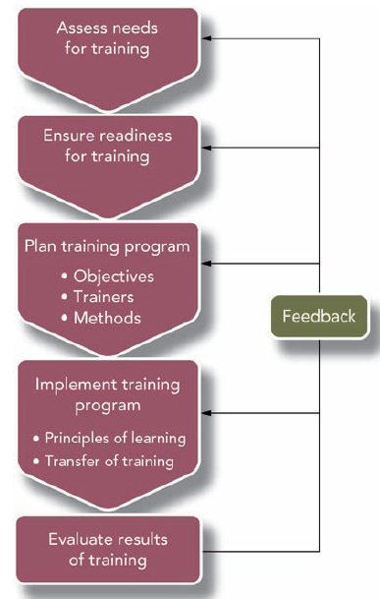
Training should be linked to ORGANIZATIONAL NEEDS!
Stages of Instructional Design (fig 7.1)

Slide 5
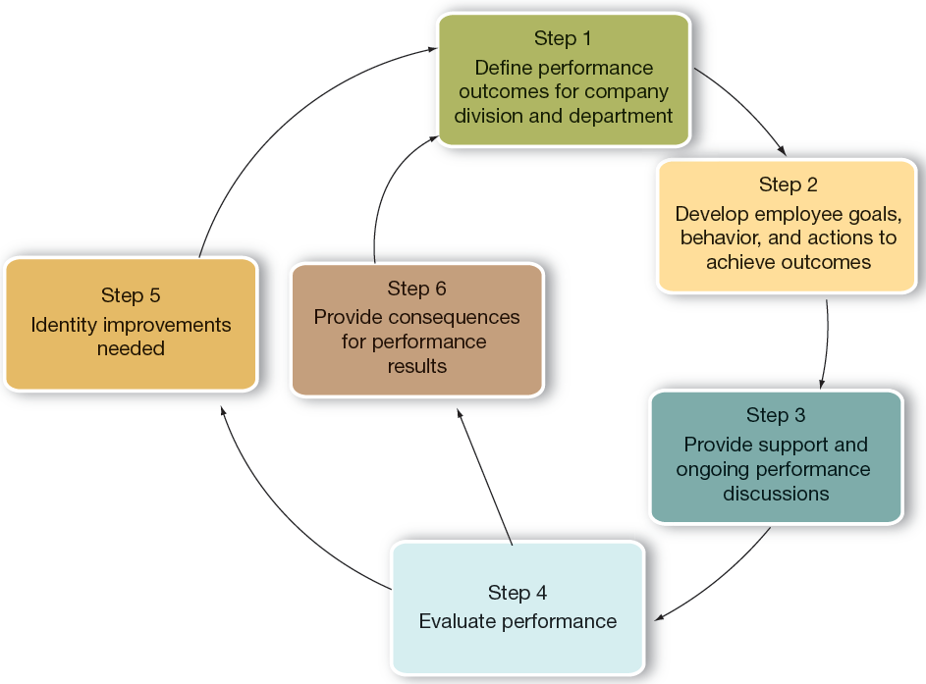
Chapter 8 - Performance Management
Figure 8.1

Slide 6
What is Performance Management?
The process managers use to make sure employees’ work activities and outputs are contributing to organizational goals.

Slide 7
3 reasons we do PM:
Strategic
  PM helps an organization achieve its business objectives (making money, treating patients, registering voters, etc...)
Administrative
  Provides info for decision-making (e.g., salary)
Developmental
  Developing KSAOs

Slide 8
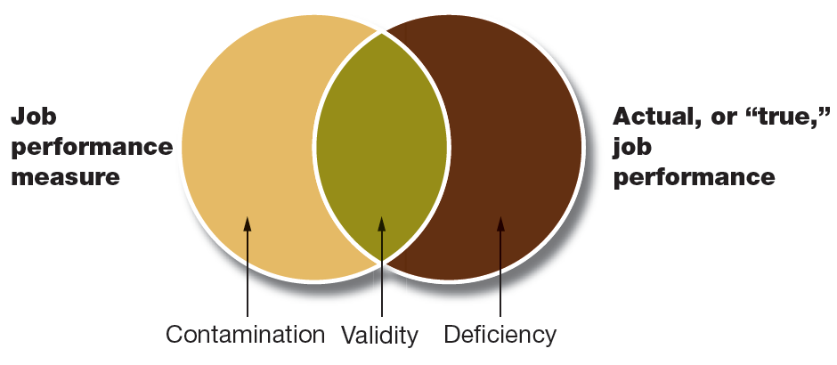
Conducting Effective PM
Fit with organizational strategy
Validity
Reliability
Acceptability
Specificity
  What exactly are EEs doing right or wrong

Slide 9
Test Your Knowledge...
If your company’s performance management system created unhealthy competition among teams of employees, you might consider:
  A) Focus on attributes rather than behaviors
  B) Doing nothing. Competition is good!
  C) Increasing the specificity of PM feedback
  D) Adding collaboration as a performance criteria

Slide 10
Test Your Knowledge...
Sarah is a computer programmer whose job mainly consists of coding software independently. Teamwork skills are included on her performance appraisal. Measuring these skills most closely represents:
  A) Criterion deficiency
  B) Test-retest unreliability
  C) Criterion contamination
  D) Lack of specificity

Slide 11
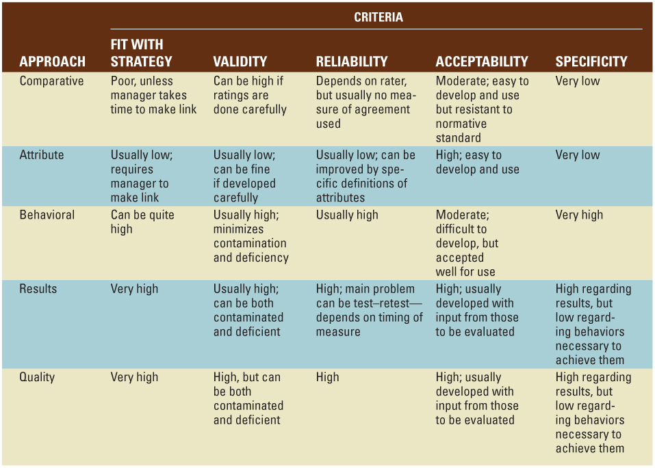
PM Methods
Rankings
Ratings
Not EE-related

Slide 12
Making Comparisons (Ranking)
Manager ranks their subordinates performance against one another
  Simple ranking (#1, #2, #3...)
    Alternation (Best, worst, 2nd best, 2nd worst...)
  Forced-distribution
    Exceptional (5%), Exceeds standards (25%), Meets standards (55%), Needs improvement (10%), Unacceptable (10%)

Slide 13
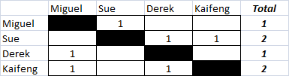
Making Comparisons (cont.)
Paired comparison
  4 EEs: Miguel, Sue, Derek, Kaifeng

Slide 14
Rating Employees
Comparing EE performance against a prescribed set of standards (rather than against each other)
Can rate attributes (EE traits) or behaviors, or both
Rating attributes is the most used method in organizations (p. 243). Why?

Slide 15
Rating EE Behaviors
Critical incident method
  Specific examples of effective/ineffective behaviors
BARS (behaviorally-anchored rating scale)
  Rating on many job-relevant behaviors
BOS (behavioral observation scale)
  Rating on all behaviors necessary
  Cumbersome, but yields excellent results

Slide 16
Where can we get performance information from?
Managers
Peers
Subordinates
Self
Customers/Clients
360-degree feedback

Slide 17
Potential PM Errors...
EEs similar to us tend to get rated higher
Contrast error
  Good may seem less than good, when compared to outstanding
Distributional errors (too far to one side)
  Leniency...central tendency...strictness
Halo/Horns error
  Halo example: staying late at work every day

Slide 18
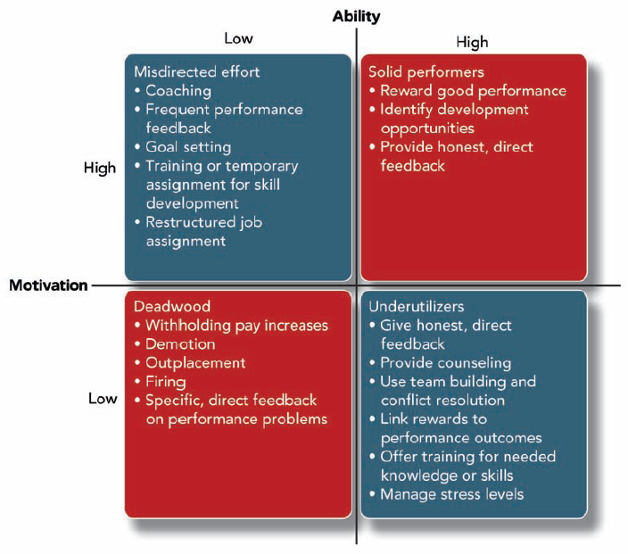
How to deal with performance problems
Low A
High M
High A
High M
Low A
Low M
High A
Low M

Slide 19
Chapter 9 - Employee Development

Slide 20
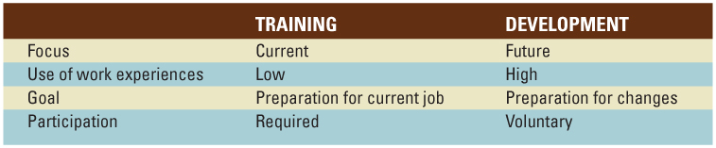
How is Development different from Training?
Future...
High use of job experiences (such as job rotation)...
Preparation for changes in job TDRs
Voluntary participation

Slide 21
Development is key for the “Protean” Career...
...a career that frequently changes based on changes in the person’s interests, abilities, and values and in the work environment.

Slide 22
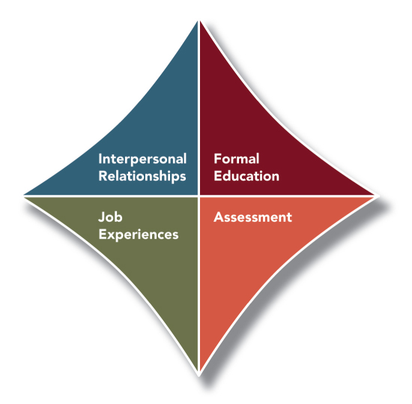
4 approaches to EE Development

Slide 23
1) Formal Education
Traditional school-based
  On-campus master’s degree
  Online
In-house
  Hamburger U

Slide 24

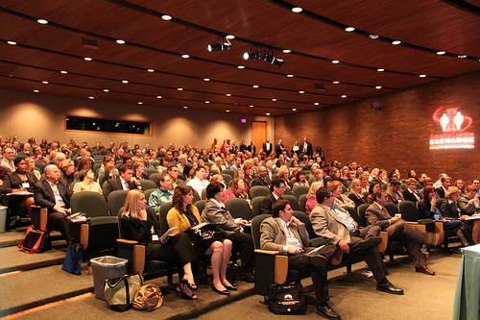


Slide 25
2) Job Experiences
Using job enrichment and/or positional movement to develop a worker’s KSAOs
  Job enlargement, job rotation
  Transfers, promotions
  Externships, sabbaticals

Slide 26
3) Interpersonal Relationships
Mentoring (passive, low contact)
Coaching (active, high contact)

Slide 27
4) Assessments
Performance appraisals/360-Degree feedback
Benchmarks/Assessment centers
MBTI
  Myers-Briggs Type Indicator (gauges an individual’s work preferences)

Slide 28
Breaking the “Glass Ceiling”
Organizationally-developed systems
  Coca-Cola example

Slide 29
Chapter 10 - Managing Turnover

Slide 30
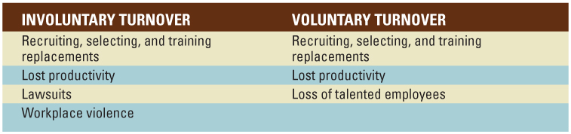
Turnover is Costly!
Successful companies require satisfied, loyal EEs!
Firms with low turnover perform better!

Slide 31
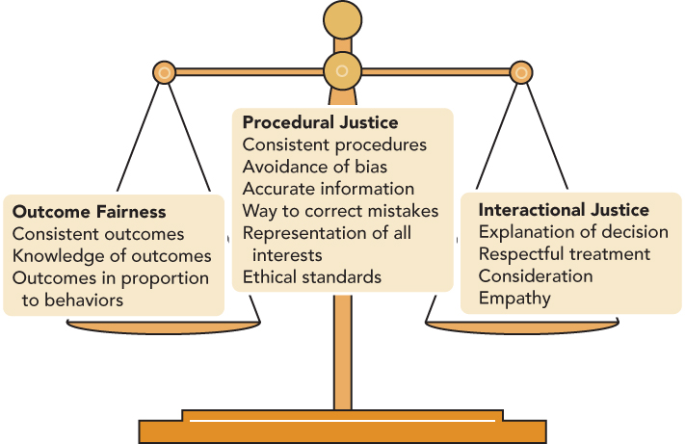
Terminations should be FAIR!
More commonly called:
“Distributive Justice”

Slide 32
Progressive Discipline
Hot-Stove Rule -- organizational discipline should:
  Give clear warning
  Deliver consistent consequences
  Deliver objective consequences
  Deliver immediate consequences

Slide 33
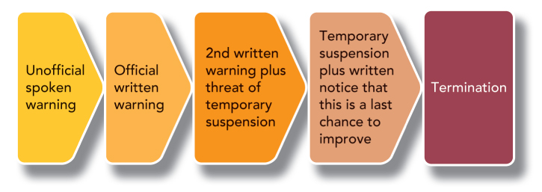
Progressive Discipline (example)

Slide 34
Plant Closings/Mass Layoffs
W.A.R.N.
  Worker’s Adjustment Retraining & Notification Act
  Firms w/ more than 100 EEs
  60-day notice
  If restructuring will affect 50 or more EEs

