Slide 1
Model Samples and Research Methods
There are an Infinite number of possibilities mathematically BUT NOT NECESSARILY theoretically!!!

Slide 2
Problem to Test Statistic Chain Relationships
 | Definition | The research question | The hypothesis | The methodology | The statistical test | The test statistics
The problem | Identifies an area that needs to be corrected or addressed | Is a rephrasing of the problem into a question | Is a relationship within or between variables that if demonstrated addresses the problem | The methodology is the set of procedures that gathers data within the environment that the problem manifests itself
The research question | A statement, that if answered addresses the problem |  | Is a relationship that if demonstrated, answers the question | The methodology is a set of procedures that gathers data within the environment where the research questions are be answered
The hypothesis | A relationship within or between constructs/variables that if demonstrated in a statistically acceptable manor, answers the question |  |  | Is a means to gather data in a manor that allows addressing the hypothesis and accounts for the environment and sample (population) under investigation
The methodology | A procedures used to gather appropriate data to ensure that the statistical test will actually address the hypothesis |  |  |  | The statistical test is only relevant if appropriate data is gathered using a specifies methodology for the environment and for the sample in which the phenomena is present
The statistical test | A procedure using tools/software that is run using appropriate data gathered using a methodology to address the hypothesis |  |  |  |  | The test statistic is unique to each statistical procedure

Slide 3
Problem through Test Statistics and Control Chain Examples
Problem | The research question | The hypothesis | The methodology | The statistical test | The test statistics | Controls i.e. factors that are NOT theorized to affect the results | Sample Size
There are positive or negative differences between 2 or more groups in an environment (team, company etc..). The differences are a problem. | Are there differences between 2 or more groups in an environment (team, company, etc..) | The two groups that demonstrate XXX in an environment are different. | Gather a enough data (sample size) related to the problem in the environment for each group depending on the number of variables (indicators) and the number of controls. | The means of each group(s) are different (ANOVA or MANOVA) regardless of the controls i.e. the controls do not matter | Difference in means with a p-value(s). The control groups do not show a difference than the main groups | Age, education, years of experience, position in organization, gender, ethnicity to ensure that these ARE NOT the problem | Obtain samples large enough for the statistical tests AND to break up into groups per the controls
Something(s) is(are) affecting something else in positive or negative way within an environment. The Effect(s) is (are) the problem. | Does XXX (or Do XXX, WWW, and NNN) affect YYYY in an environment (team, company, etc..) | XXX(and WWW NNNn) affect(s) YYYY in a(n) environment (team, company, etc..) | Gather enough data (sample size) related to XX (and WWW, NNN) and gather data related to YYY in the environment depending on the number of variables (indicators) and the number of controls. | XXX (and WWW, NNN) predicts YYYyy (Regression singular or multiple or SEM) regardless of the controls i.e. the controls do not matter | beta weight(s) or path coefficients and statistically significant p-value(s) The control groups do not show a difference. | Age, education, years of experience, position in organization, gender, ethnicity to ensure that these ARE NOT the problem | Obtain samples large enough for the statistical tests AND to break up into groups per the controls
Something(s) is(are) interacting with other things that are then affecting something else in positive or negative way within an environment. Effect(s) is (are) the problem. | Does XXX (or Do XXX, WWW, and NNN) interact with MMM, EEE to affect YYYY in an environment (team, company, etc.) | XXX(and WWW NNNn) affect(s) interacts with MMM or EEE YYYY in a(n) environment (team, company, etc.) | Gather data related to XX (and WWW, NNN), MMM, EEE, and gather data related to YYY (y1, y2 etc.) in the environment depending on the number of variables (indicators) and the number of controls. | XXX (and WWW, NNN) predicts via moderation or mediation with YYY (Regression singular or multiple with moderation or mediation or SEM) regardless of the controls i.e. the controls do not matter | beta weight(s) or path coefficients and p-value(s) of the moderation or mediation are GREATER and statistically significant than without the moderation or mediation. The controls are NOT significant | Age, education, years of experience, position in organization, gender, ethnicity to ensure that these ARE NOT the problem | Obtain samples large enough for the statistical tests AND to break up into groups per the controls

Slide 4

Group differences for the same phenomena
Tested using ANOVA i.e. difference in means and p-value
Environment/Population
Indicators
Group 1
Indicators
Phenomena XXX
(aka variable)
=
Group 2
Indicators
=
Group n
Example
Research Question : In an organization, do different age groups (or education level groups) demonstrate different levels of commitment (the phenomena)?
H: Different age groups (or education level groups) demonstrate different levels of commitment (the phenomena).

Slide 5
Phenomena XXX RELATED to Phenomena YYY
Tested via Correlation and p-value
Environment/Population
Indicators
Indicators
Indicators
Phenomena
XXX
Pierson's correlation
and p-Value
Phenomena
YYY
Indicators
Indicators
H1
Indicators
Example
Research Question : In an organization, is the time in the organization (a phenomena) related to the level of commitment (a phenomena)?
H1: Time in the organization (a phenomena) is related to the level of commitment (a phenomena)

Slide 6
Phenomena XXX affects (or predicts) Phenomena YYY
can be done with Regression or SEM
Environment/Population
Indicators
Indicators
Phenomena
XXX
(Independent
Variable – IV)
Beta Weight
Or and p-Value
Path Coefficient
Phenomena
YYY
(Dependent
Variable - DV)
Indicators
Indicators
Indicators
H1-
Indicators
Example
Research Question : In an organization, does level of commitment affect turnover intention?
H1: In an organization, level of commitment negatively affects turnover intention

Slide 7
Phenomena's XXX and WWW affect (or predict) Phenomena YYY
Can be Accomplished with Regression or SEM
Environment/Population
Indicators
Phenomena
XXX
(Independent
Variable – IV)
H1-
Indicators
Phenomena
YYY
(Dependent
Variable -DV)
Indicators
Beta Weight
Or and p-Value
Path Coefficient
Indicators
Indicators
Indicators
Beta Weight
Or and p-Value
Path Coefficient
Indicators
Phenomena
WWW
(Independent
Variable – IV)
H2-
Indicators
Indicators
Example
Research Question : In an organization, do level of commitment and servant leadership affect turnover intention?
H1: Level of commitment negatively affects turnover intention
H2: Servant leadership negatively affects turnover intention

Slide 8
Phenomena's XXX and WWW affects or predicts Phenomena YYY1 and YYY2
Can be Accomplished with Regression or SEM
Environment/Population
Indicators
Phenomena
XXX
(Independent
Variable – IV)
Phenomena
YYY1
(Dependent
Variable -DV)
Indicators
H1-
Indicators
Beta Weight
Or and p-Value
Path Coefficient
Indicators
Indicators
H2+
H3-
Indicators
Beta Weight
Or and p-Value
Path Coefficient
Indicators
Phenomena
YYY2
(Dependent
Variable -DV)
Indicators
Phenomena
WWW
(Independent
Variable – IV)
Indicators
Indicators
H4+
Indicators
Indicators
Example
Research Question: In an organization, do level of commitment and servant leadership predict turnover intention and productivity?
H1: Level of commitment negatively affects turnover intention
H2: Level of commitment positively affects productivity
H3: Servant leadership negatively affects turnover intention
H4: Servant leadership positively affects productivity

Slide 9
Phenomena's XXX affects on Phenomena YYY is fully or partially Mediated by Phenomena EEE
Can be Accomplished with Regression or SEM
Indicators
Environment/Population
Indicators
Phenomena
EEE
(Mediator)
Indicators
Indicators
Phenomena
XXX
(Independent
Variable – IV)
H1+
H2+
Phenomena
YYY
(Dependent
Variable - DV)
Indicators
Indicators
H3+
Indicators
Beta Weights
Or and p-Values
Path Coefficients
Indicators
Indicators
Example
Research Question: In an organization, does Level of Commitment (ME), mediate the relationship between Servant Leadership (IV) and Productivity (DV)?
H1: Servant Leadership positively affects Level of Commitment
H2: Level of Commitment positively affects to productivity
H3: Servant Leadership positively affects to Productivity
Full Mediation: The H3 relationship is zero in presence of Commitment
Partial Mediation: H2 is stronger than H3

Slide 10
Phenomena's XXX affects on Phenomena YYY is moderated by Phenomena MMM
Can be Accomplished with Regression or SEM
Environment/Population
Indicators
Phenomena
MMM
(Moderator)
Indicators
Indicators
Indicators
Phenomena
XXX
(Independent
Variable – IV)
H2+
Phenomena
YYY
(Dependent
Variable - DV)
Indicators
Indicators
Beta Weight
Or and p-Value
Path Coefficient
Indicators
H1+
Indicators
Indicators
Example
Q: In an organization, does amount of training, moderate the relationship between servant leadership (IV) predict productivity (DV)
H1: Servant Leadership positively affects Productivity
H2: Level of Training increases relationship between Servant Leadership and Productivity

Slide 11
More Complicated Models
Are better suited for SEM
Indicators left out for simplicity
Moderating
Variable (MV)
Environment/Population
Phenomena
MMM
Independent
Variable (IV)
Mediator
Variable (ME)
Mediator
Variable (ME)
Dependent
Variable (DV)
Phenomena
XXX
Phenomena
EEE1
Phenomena
EEE2
Phenomena
YYY
Phenomena
WWW
Independent
Variable (IV)

Slide 12

Psychometric Variables vs. Control or Directly Measurable Variables
Psychometric Variable
  Measure an individuals “perception” of a Construct
    Leadership
    Perceived Usefulness
  Must be assessed for Reliability and Validity because it is a perception!
    Contain measurement error!!
Control Variable/Directly Measured Variables
  Are not approximations (i.e. contain no measurement error – they are absolute – always or at specific point in time
    Gender
    Age
    Education
    Years in Workforce
    Sales for the year
  ARE NOT assessed for reliability or validity because they are irrefutable!
    contain no measurement error – they are absolute – always or at specific point in time

Slide 13
Frequent Student Challenges
Not understanding the stages (steps) required for data analysis and why each is accomplished
  Data cleansing first – remove bad data or add missing data
  Data validity next – ensure we are correctly measuring the variables in our model
  Variable relationships last – do the hypothesis hold valid?
Not understanding which tools can be for specific steps

Slide 14
Why Do We…..
Clean the data first
  To remove data that could produce bad indicators
  i.e. some subjects did not answer the questions in a manor consistent with the way other subject did
Add missing data i.e. only one or two indicators from a responder
  So that we can make use of a otherwise good data
Assess the indicators and variables next
  Because if we are not measuring what we think we are measuring, our hypothesis testing will not be justified!
Assess the variable relationships last
  This is the goal!!!!!

Slide 15
Terms that refer to the same ideas or are related
Scale = measures = set of Items = questions related to a variable = questions that measure a construct
  This leads to terms and related quality assessment mechanisms such as 1) measurement instrument, or 2) item reliability, 3) scale reliability, or) 4) internal consistency reliability
Construct = factor = variable
  The term “Construct” is used in theoretical model – it is a theoretical phenomena of interest that cannot be readily measured
  The term “Factor” is used when looking all phenomena that are present in an environment
  The term “Variable” refers to the operationalization version of a construct which is measured using indicators
  Note by equal ( = ), I mean “related” in some cases

Slide 16
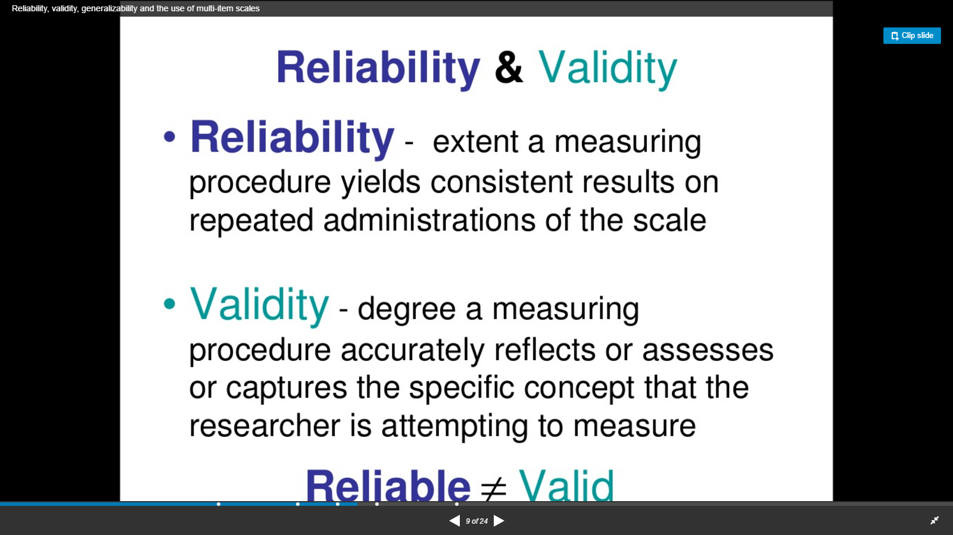
http://www.slideshare.net/DrAkterCMC/reliability-validity-generalizability-and-the-use-of-multiitem-scales

Slide 17
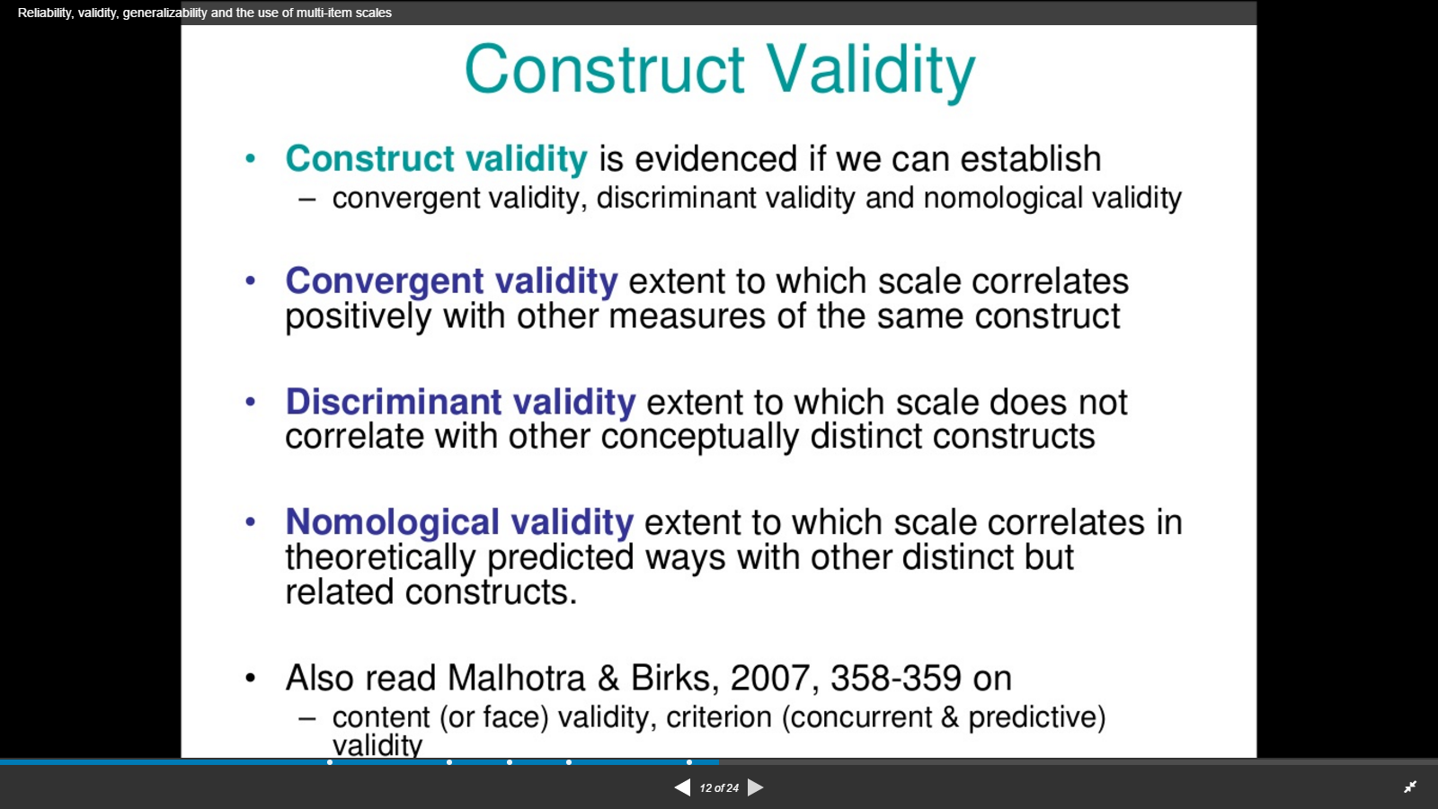
http://www.slideshare.net/DrAkterCMC/reliability-validity-generalizability-and-the-use-of-multiitem-scales

Slide 18
The Operationalized Model – All Reflective Indicators
Fair 1
Fair 2
REP 1
Fair 3
REP 2
Fair 4
REPUTATION
REP 3
Fair 5
FAIRNESS
REP 4
OrgCare 1
REP 5
OrgCare 2
OBSE 1
ORG_CARE
OBSE 2
OrgCare 3
OBSE
OrgCare 4
OBSE 3
OrgCare 5
OBSE 4
AUTHORITY
OBSE 5
Author 1
Author 2
Author 3
Author 4
Author 5

Slide 19
The Measurement Instrument/Measurement Model
(What is Indicator Reliability and Internal Consistency Reliability – What are the Differences?)
Fair 1
Indicator Reliability -
How well a single indicator measures the variable
Fair 2
REP 1
Fair 3
REP 2
Fair 4
REPUTATION
REP 3
Fair 5
FAIRNESS
REP 4
OrgCare 1
REP 5
OrgCare 2
OBSE 1
ORG_CARE
OrgCare 3
OBSE
OBSE 2
OrgCare 4
OBSE 3
OrgCare 5
OBSE 4
AUTHORITY
OBSE 5
Internal Consistency Reliability
A total measure of how well ALL the indictors support measuring the construct/variable
Author 1
Author 2
Author 3
Author 4
Author 5

Slide 20
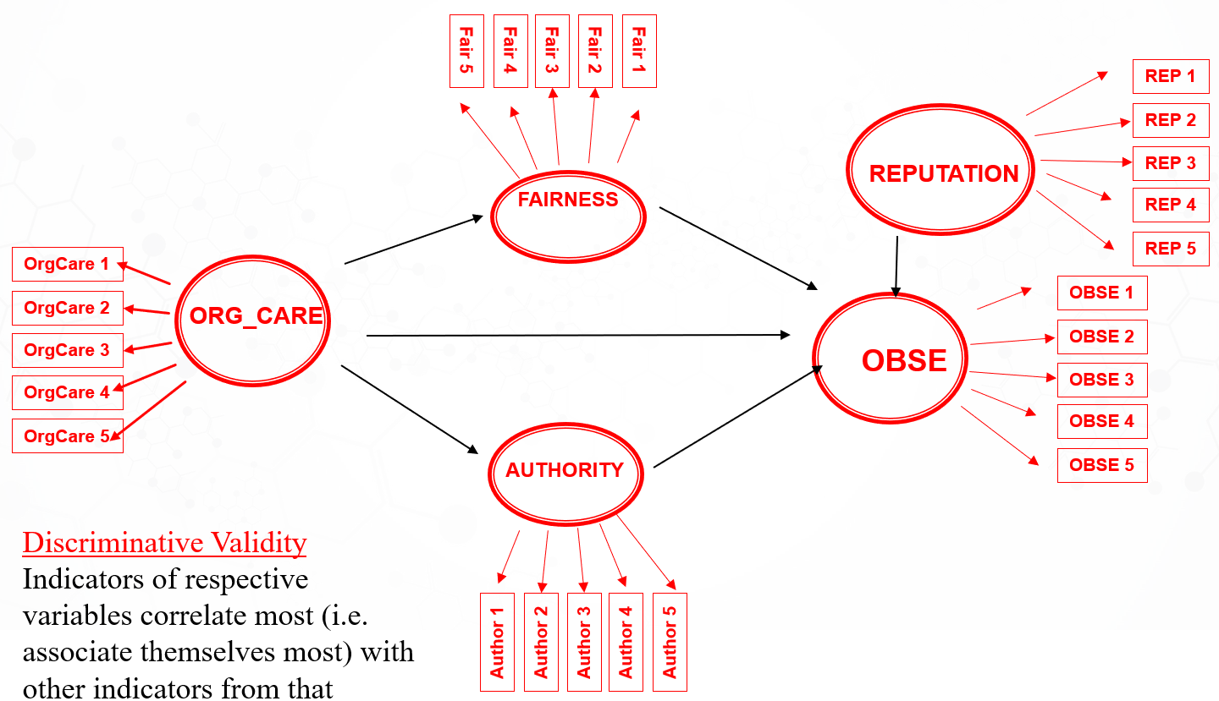
The Measurement Instrument/Measurement Model
(What is Discriminative Validity?)
all other individual correlations lower and may be significant or not
X
correlations strongest
and significant
Discriminative Validity
Indicators of respective variables correlate most (i.e. associate themselves most) with other indicators from that variable

Slide 21
The Measurement Instrument/Measurement Model
(What is Convergent Validity?)
Fair 1
Fair 2
X
REP 1
Fair 3
REP 2
Fair 4
Factor 3
REP 3
Fair 5
Factor 2
REP 4
OrgCare 1
REP 5
OrgCare 2
OBSE 1
Factor 1
OrgCare 3
Factor 4
OBSE 2
OrgCare 4
OBSE 3
OrgCare 5
OBSE 4
Factor 5
OBSE 5
Author 1
Convergent Validity
Associated Indicators converge (i.e. align themselves most) on an unnamed factor.
Author 2
Author 3
Author 4
Author 5

Slide 22
The Regression, Path, or Structural Model
Coefficients, p-values, R²
Fair 1
Fair 2
REP 1
Fair 3
REP 2
Fair 4
REPUTATION
REP 3
Fair 5
FAIRNESS
R²
REP 4
OrgCare 1
REP 5
OrgCare 2
Regression or Beta Weight or
Path Coefficient and p-value
OBSE 1
ORG_CARE
OBSE
R²
OBSE 2
OrgCare 3
OrgCare 4
OBSE 3
OrgCare 5
OBSE 4
AUTHORITY
R²
OBSE 5
R²
How much the variation in a dependent or mediating variable is explained by the related independent variables.
Author 1
Regression/Beta Weigh/Path Coefficient
How much change does one variable create on another
and p-value – ex. 0.05
Probability that the result IS by chance
1 minus p-value - ex 0.95
Probability that result holds true
Author 2
Author 3
Author 4
Author 5

Slide 23
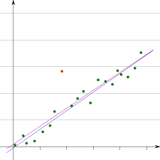
What is an Outlier
Removal of Outliers – i.e. removal of specific responses not behaving similar to rest
Google
  Data Analysis Outliers
Two Variable Example
Correlation Plot Tool
Outlier

Slide 24
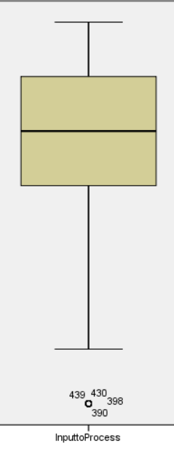
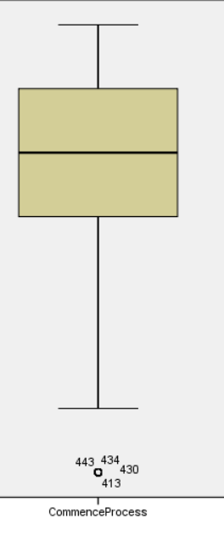
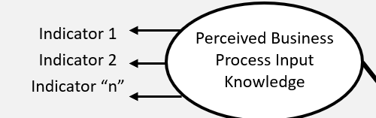
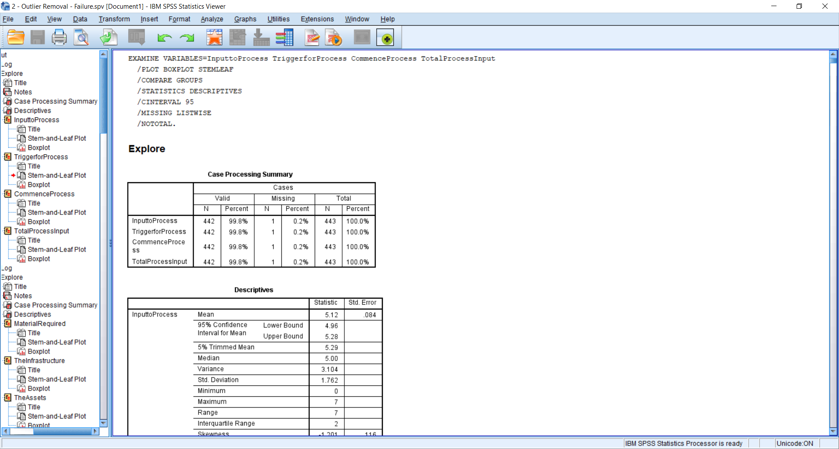
Data Cleansing – Outlier Removal by Variable
i.e. Assess Indicators Associated with One Variable
4 Indicators Example - Box Plot Tool – Sample Size 442
Indicator # 1
Indicator # 2
Any Variable
Indicator 1
Indicator 2
Indicator 3
Indicator 4
Outliers
(Response #’)
Indicator # 1
Indicator # 2

Slide 25
Measurement Model Validity - Are we Actually Measuring the Variables?
Reflective Indicators Variables ONLY
Area to Assess | Simple Definition | SPSS | Smart PLS
Reliability
Indicator Reliability | Does the indicator consistently measure the variable? | Indicator Loading on Variable Greater than 0.7 and p value > 0.05 | Indicator Loading on the Variable Greater than 0.7 and p value > 0.05
Internal Consistency Reliability | Are the items measuring the same thing? | Cronbach Alpha > 0.7 | Cronbach Alpha, Composite Reliability, or Average Variance Extracted (AVE) All greater than 0.7
Validity
Convergent Validity | Does a set of indicators represents the same underlying construct | Factor Analysis - Correlations between associated indicators are greater than with others. | Average Variance Extracted (AVE) is greater than 0.5
Discriminant Validity | Do indicators for different constructs only align to their own constructs. | Factor Analysis – Related Indicators load highest on the same factor | AVE of each variable should be greater than squared correlations or Indicators should not have higher correlations with other variables.
What kinds of issues have you seen people experiencing?

Slide 26
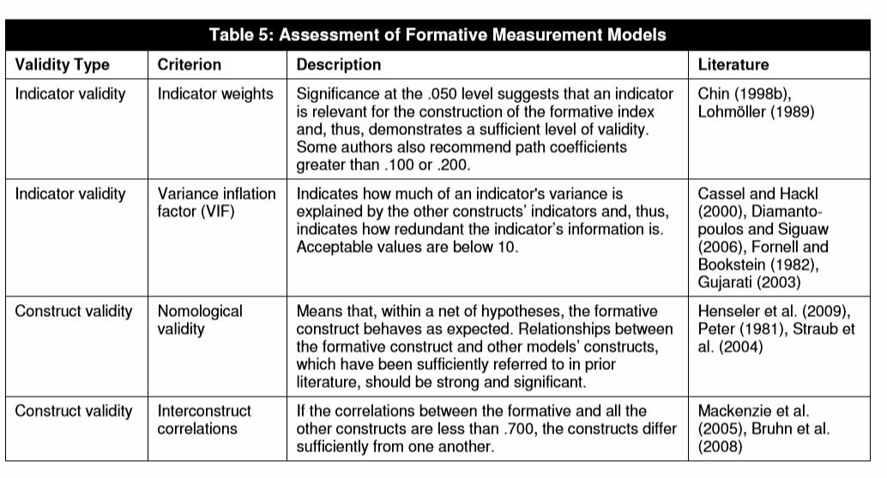
Measurement Model Validity - Formative Variables ONLY
Can ONLY be done with SEM Tools - Will NOT work with SPSS

Slide 27
Structural Model Assessment
Relationships Between Variables
Area to Assess | Simple Definition | SPSS | Smart PLS
Explained Variance (Explanatory Power) (Measured at the affected Variable) | How much the variation in a dependent is explained by the related independent variables. | R² Values of 0.67, 0.33, and 0.19 as large, moderate, and low levels | R² Values of 0.67, 0.33, and 0.19 as large, moderate, and low levels
The following are measured on the path between 2 variables
Effect Size | What is the strength of the relationship between 2 variables | Must be Calculated Manually Effect Size = f²= R²/(1-R²) Only simple to do for single (one to one) dependent to Independent Variable relationships Values of 0.35, 0.15, and 0.02 represent large, medium, and small effects | Effect Size = f² Values of 0.35, 0.15, and 0.02 represent large, medium, and small effects
Predictive Behavior Path Coefficient or Beta Weight | How much change does one variable create on another | Beta Weight with p value Predictive validity variable, we would hope for a beta coefficient coefficient of at least 0.2, p-value less than 0.1, 0.05, 0.01 | Path Coefficient with p-value Predictive validity variable, we would hope for a path coefficient of at least 0.2, p-value less than 0.1, 0.05, 0.01
Predictive Behavior Q² | Is the change in the affect variable actually due to changes affecting variable | Not calculated | Predictive Relevance Q² ^{Should be > 0 and Positive}
What kinds of issues have you seen people experiencing?

Slide 28
Advice
Make sure you understand:
  Which tool is used for which data analysis
  Which statistic is used to report each data analysis
As you come across articles related to variables you are studying …..pay attention to:
  The tools used and
  The means to display results
Remember – Not all hypothesis are quantitative – some are qualitative – i.e. demonstrated via rigorous presentation of an argument/defense
Ask Questions throughout this and every class.

Slide 29
Email Questions to
Jose.angeles@trident.edu

