Slide 1
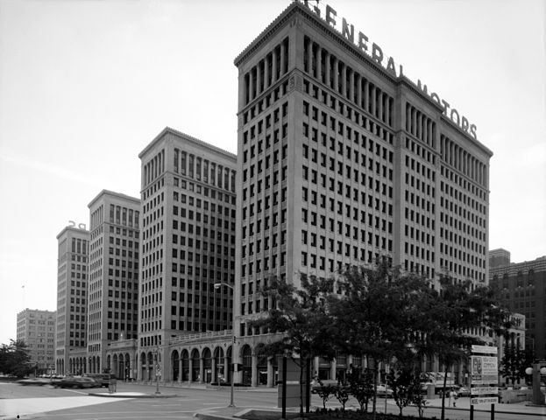
General Motors
Case Study Strategic planning
Chris Simeone & Hakeem

Slide 2
History
General Motors was capitalized by William C. Durant on September 16, 1908 as a holding company. The next day it purchased Buick Motor Company, and rapidly acquired more than twenty companies including Oldsmobile, Cadillac, Oakland, now known as Pontiac, and McLaughlin of Canada.
1918 also saw personnel increase at GM. The number of employees grew from about 49,000 workers to 85,000 workers. Many came from the South of the United States, as well as from Europe, to work at GM Michigan facilities. To accommodate them, GM began to build employee housing with the nearly $2.5 million set aside for the project. This would become one of General Motors top 5 expenditures for the year 1919. 1919 also brought changes to employee investment opportunities. Similar to modern day 401(k) plans, all employees could invest a percentage of their wages or salary. GM proceeded to match every penny that their employees invested.
By 1935, GM was the largest producer of vehicles in the world. and by 1940 it had produced 25 million cars.
In 1949, GM president Charles Wilson signed “The Treaty of Detroit,” an agreement with the United Auto Workers that guaranteed pensions and other long-term benefits for the company’s thousands of workers.
In 1980, the company posted its first financial loss in 60 years, and it continued to struggle financially through the ’80s, ’90s and 2000s.
In December 2008, it received a bailout from the federal government, which began to oversee the company’s finances.

Slide 3
History Continued
On June 1, 2009, after heavy losses, General Motors went bankrupt. Stockholders lost essentially all of their investment.
On July 10, 2009, General Motors emerged from government backed Chapter 11 reorganization after an initial filing on June 8, 2009.Through the Troubled Asset Relief Program the US Treasury invested $49.5 billion in General Motors and recovered $39 billion when it sold its shares on December 9, 2013 resulting in a loss of $10.3 billion. The Treasury invested an additional $17.2 billion into GM's former financing company, GMAC (now Ally). The shares in Ally were sold on December 18, 2014 for $19.6 billion netting $2.4 billion. A study by the Center for Automotive Research found that the GM bailout saved 1.2 million jobs and preserved $34.9 billion in tax revenue.
Also in 2009 as part General Motors Chapter 11 Bankruptcy, the company shed several brands, closing Saturn, Pontiac, and Hummer, while selling Saab Automobile to Dutch automaker Spyker, and emerged from a government-backed Chapter 11 reorganization. In 2010, the reorganized GM made an initial public offering that was one of the world's top five largest IPOs to date and returned to profitability later that year.
General Motors led global vehicle sales for 77 consecutive years from 1931 through 2007, longer than any other automaker, and in 2012 was among the world's largest automakers by vehicle unit sales.
General Motors employs 181,000 people and does business in more than 140 countries across 23 time zones.
General Motors produces vehicles in 37 countries under twelve brands: Chevrolet, Buick, GMC, Cadillac, Holden, HSV, Wuling, Baojun, Jie Fang, and Ravon.

Slide 4
General Motors Mission Statement:
G.M. is a multinational corporation engaged in socially responsible operations, worldwide. It is dedicated to provide products and services of such quality that our customers will receive superior value while our employees and business partners will share in our success and our stock-holders will receive a sustained superior return on their investment.

Slide 5
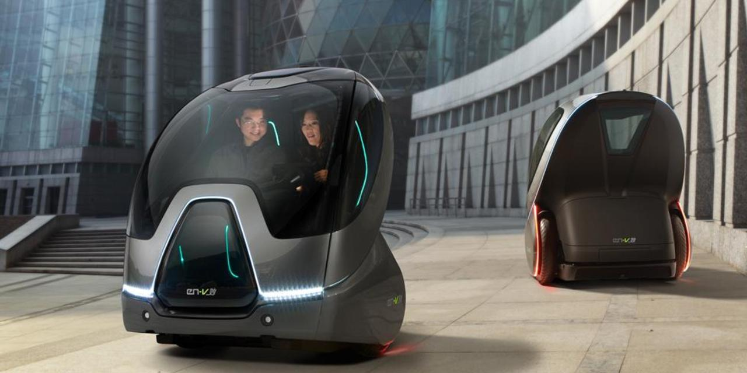
GM’s Vision StATEMENT
"Over the past 100 years, GM has been a leader in the global automotive industry. And the next 100 years will be no different. GM is committed to leading the industry in alternative fuel propulsion."
"GM’s vision is to be the world leader in transportation products and related services. We will earn our customers’ enthusiasm through continuous improvement driven by the integrity, teamwork, and innovation of GM people."

Slide 6
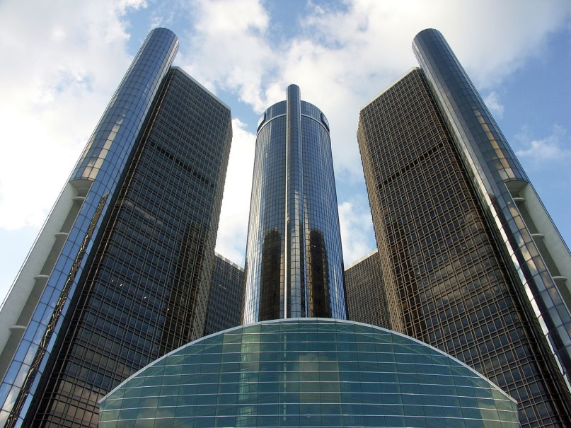
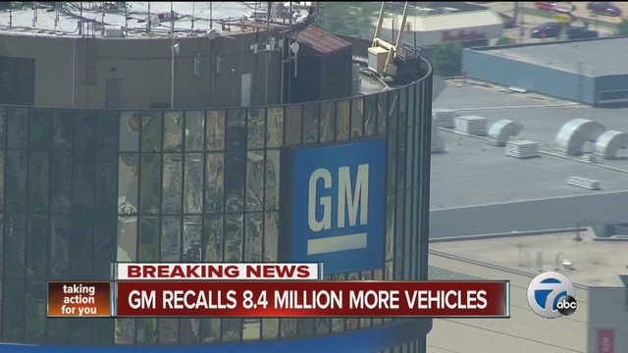
General Motors Issues
Customer Satisfaction-
  66 different recalls impacting 30 million vehicles! 30 million cars worldwide recalled; paid compensation for 124 deaths; forfeited $900 million to the United States
Vehicle Safety-
  On February 6, 2014, General Motors recalled about 1,600,000 of its small cars due to faulty ignition switches, which could shut off the engine during driving and thereby prevent the airbags from inflating.
Fuel efficiency & CO2 emissions-
  GM has received many criticisms from critics for sticking to its overhead valve "small block" engine architecture that dates back to the early 1950s and is very outdated.
Worker Satisfaction-
  In recent year, the union tried to win wage increases for autoworkers after years of rising sales and profits among U.S. automakers while the manufacturer wanted to hold down labor costs so they can remain competitive with their Asian and German rivals. The union was met with stiff resistance from GM to settle contracts.

Slide 7
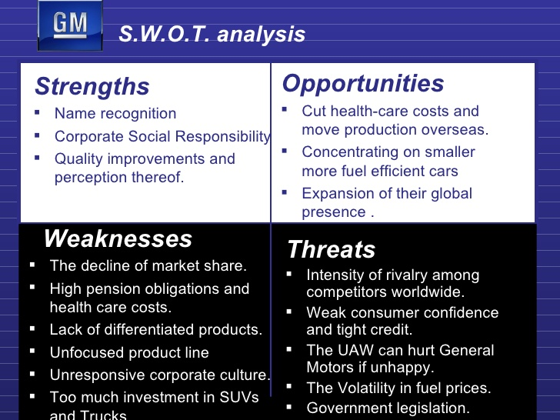

Slide 8
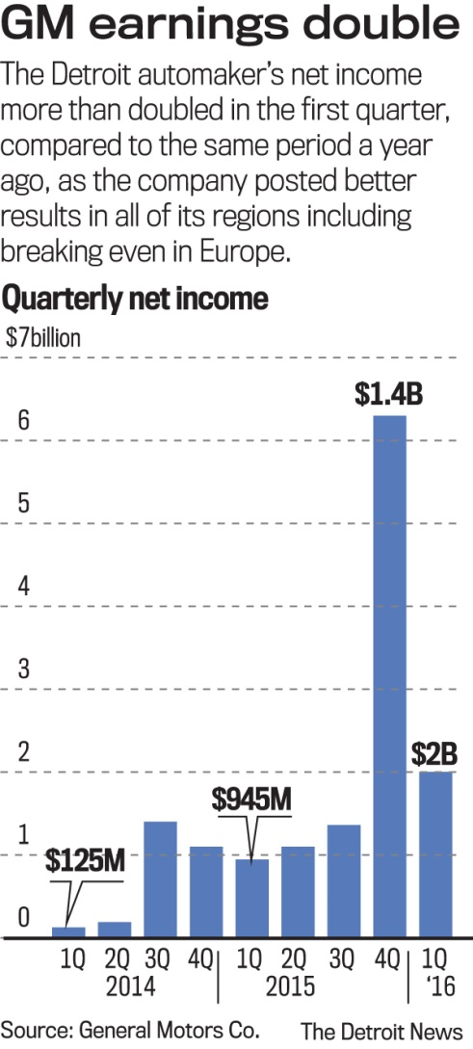
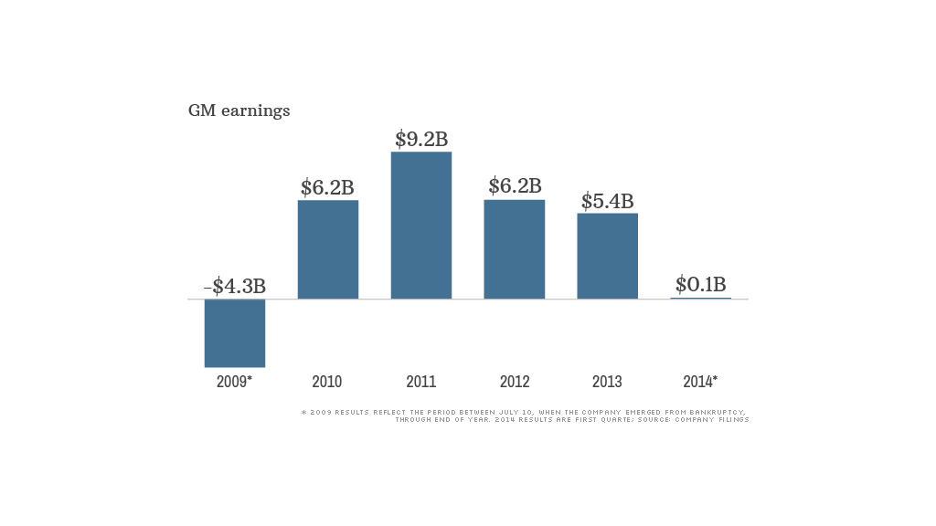
GM’s Earnings

Slide 9
Solutions
Customer Satisfaction
Earning customers for life is the foundational promise of General Motors. It is a commitment to treat every customer with respect. To care about a customer, not just when they purchase a new vehicle, but for as long as they own the vehicle. Appreciating customers and fighting every day to earn their loyalty inspires us to make better, safer, higher value cars, trucks and crossovers.
Safety & Quality
We assign the highest priority to matters that impact our customers’ well-being and quality of life. As a result, General Motors is driven to maintain the highest quality standards. Quality and safety are part of our very foundation. Safety is something we will never compromise.
Fuel Efficiency
The 2016 Chevrolet Volt two time winner of the Green Car Of The Year Award. Historically, General Motors technology has always been on the forefront. We continue to excel in engine and drivetrain development, and strive to push exciting advancements in alternative energy and purposeful vehicle design.

Slide 10
Solutions Continued
Worker Satisfaction
We are a global team of diverse and talented people—from creative design to engineering and software development to manufacturing to marketing and finance—making contributions that extend far beyond our job titles and often bringing our life’s passion to our work.
Community Impact
Since 1976, the General Motors Foundation has donated nearly $1 billion to U.S. charities, educational organizations and disaster relief efforts worldwide. In 2016, the company began transitioning from a U.S.-focused, foundation-based giving model to a global social impact strategy to promote economic growth around the world. This strategy will advance STEM education, improve vehicle and road safety and build sustainable communities, with a special focus where GM has business units and employee presence around the world.
Innovation
General Motors announced today how it is executing on a major element of its vision of a world with zero crashes, zero emissions and zero congestion, recently announced by GM Chairman and CEO Mary Barra.
“General Motors believes in an all-electric future,” said Mark Reuss, General Motors executive vice president of Product Development, Purchasing and Supply Chain. “Although that future won't happen overnight, GM is committed to driving increased usage and acceptance of electric vehicles through no-compromise solutions that meet our customers' needs.”
In the next 18 months, GM will introduce two new all-electric vehicles based off learnings from the Chevrolet Bolt EV. They will be the first of at least 20 new all-electric vehicles that will launch by 2023.

Slide 11

Recommendations
Recalling known vehicle deficiencies.
Overhauling their corporate structure
Implementing and focusing on their core governance tools.
Implementing more safety features in vehicle and quality control.
Customer satisfaction is first
Use of green power to run their factories.
Commitment to and execute their core goals on going all electric greener vehicles.

